Slide 1
IN THE NAME OF GOD
Application of Artificial Intelligence in Research
By Sareh Bakhshandeh

Slide 3
Contents
Number
Land
step1
Openai
step2
Chatgpt
step3
Bing
step4
Agentgpt
step5

Slide 4
Number land

Slide 5
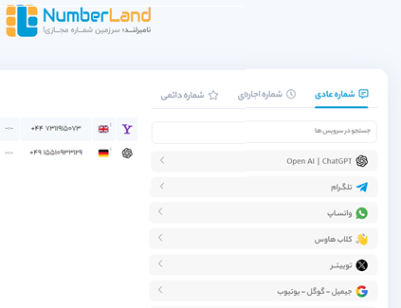
Number land

Slide 6
Openai

Slide 7
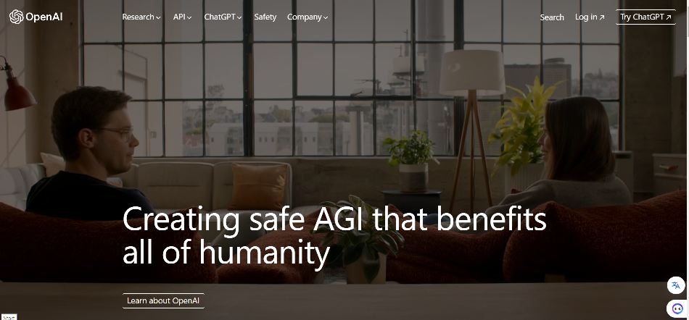
Openai

Slide 8
Chatgpt

Slide 9
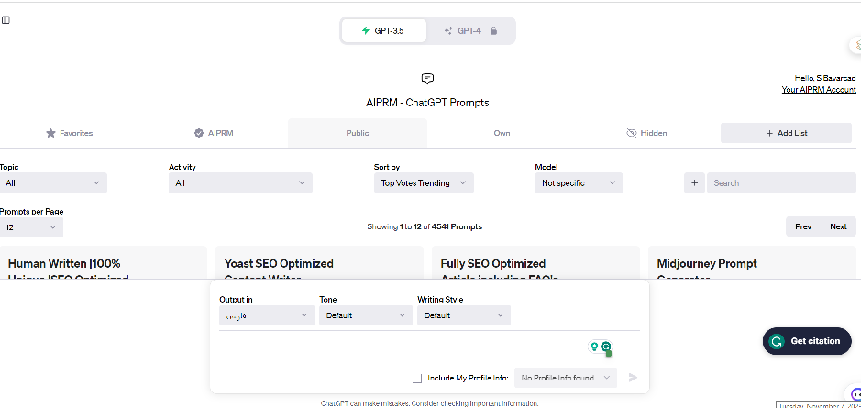
Chatgpt

Slide 10
Microsoft Bing

Slide 11
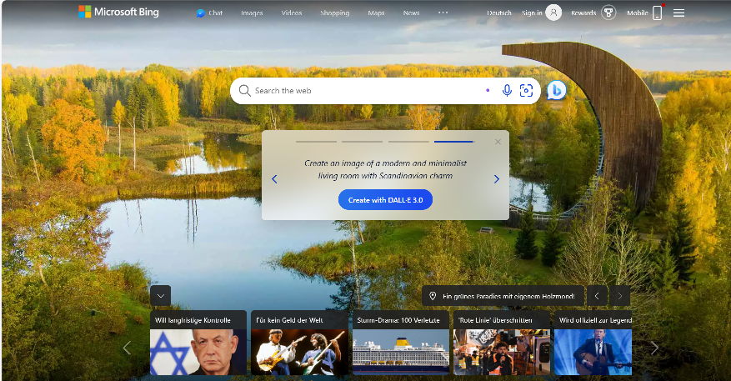
Microsoft Bing

Slide 12
THANKS
ANY QUESTION?

